Slide 1
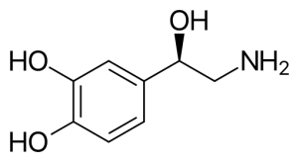
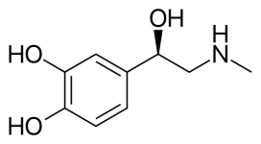
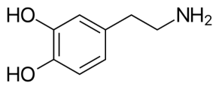
Catecholamine in Human Urine
Application Note: AGWCX10001
Agility WCX SPE Cartridges
Compounds :
Norepinephrine Epinephrine Dopamine
SPE EXTRACTION METHOD:
(Agiltiy WCX SPE cartridge, 30 mg/3cc, SYAG8030-3)
HPLC METHOD:
Column: Orochem Reliasil C18 HPLC
column 4.6x50 mm, 3 µm.
Part number: R3BI-101
Mobile phase: A: 0.1% formic acid in water
B: 0.1% formic acid in methanol
Gradient: Initial 1% B for 1 min, then gradient to 50% B at 3 min, and hold 1 min
Flow rate: 0.5 mL/min
Injection volume: 20 µL
Retention times:
Norepinephrine: 1.8 min
Epinephrine: 2.3 min
Dopamine: 3.0 min
Condition:
1 mL of ACN, followed by 1 mL of 50 mM NH₄AC
Load:
0.2 mL of human urine sample
Wash:
1 mL of 10% methanol, followed by 1 mL of IPA
Elute:
1 mL of 5% formic acid in ACN
Evaporate and Reconstitute:
200 µL of 10% methanol with 0.1% formic acid
MS/MS CONDITIONS:
Mass spectrometer: API3000
Ion source: Turbo Ionspary
Polarity: Positive
IS: 3500
Temp. 400
DP: various by analytes
CAD: 12
EP: 10
CE: various by analytes
CXP: 10
Scan mode: MRM
Steroids | Quantifier ions | Qualifier ions
 | Q1/Q3 | Q1/Q3
Epinephrine | 184.2/166.2
Norepinephrine | 170.0/152.1 | 152.1/107.0
Dopamine | 154.1/137.2 | 154.1/191.0

Slide 2
Catecholamine in Human Urine
Application Note: AGWCX10001
RESULTS:
Chemicals | Norepinephrine | Epinephrine | Dopamine
Recovery(%) | 93.9 | 99.3 | 86.8
CV(%) | 11.6 | 7.0 | 11.1

